Slide 1
Deep Dive: Creating Task From Scratch
Brandon Minnick
Code Traveler, LLC
Notes:
Welcome back. This is the last lecture of the workshop, and it sets up the final challenge. On Day 1 we watched the compiler rewrite every async method into a state machine, then we fixed the common mistakes in the HackerNews app. This morning we dug into the .NET Internals: ThreadStatic, Principal, ExecutionContext and SynchronizationContext, and we used the debugger to watch ExecutionContext flow across an await.
Now we put all of that to work. Over the next few slides you'll learn every building block a Task is made of. Then you'll open an empty class called CustomTask and build one yourself: run work on the Thread Pool, chain continuations, block with Wait(), delay with a Timer, and finally make the await keyword accept your type.
Nothing on these slides is finished solution code. Each slide shows one .NET primitive and explains how it fits. Assembling them is your job, and that's the fun part. After the challenge we'll compare approaches and walk through SOLUTION.md together.
https://github.com/dotnet/runtime/blob/main/src/libraries/System.Private.CoreLib/src/System/Threading/Tasks/Task.cs

Slide 2
Task Is Not a Thread
A Promise That Tracks Completion
Notes:
Say this out loud before writing any code: a Task is not a thread. It doesn't run anything. It's a promise. A small object that tracks whether a piece of work has finished, what the outcome was, and who is waiting to hear about it.
When you call Task.Run(), the Thread Pool does the running. The Task you get back only records the result when that work finishes. Task.Delay() uses no thread at all while it waits; a timer fires and completes the Task. When you await, nothing about the Task changes. You're asking the Task to call you back when it completes.
This is the mental model that makes the challenge feel small. Once you separate the work from the object that tracks the work, every method you need to write becomes obvious: something marks the task complete, and something registers who wants to know.
https://github.com/dotnet/runtime/blob/main/src/libraries/System.Private.CoreLib/src/System/Threading/Tasks/Task.cs

Slide 3
Task A Completion-Tracking Object
Completion State
`IsCompleted`, set exactly once
Outcome
A result, or the stored `Exception`
Continuations
Who to call when the Task completes
`Task.Run()`: queue on the Thread Pool, then complete
Notes:
Here's everything a Task actually holds. A completion flag, exposed through IsCompleted. An outcome: either a result or an exception, never both. And a list of continuations, the callbacks that should run once the task completes.
That's the whole data model. The real Task class in dotnet/runtime is thousands of lines because it also handles cancellation, schedulers, child tasks and a very clever lock-free continuation field, but the shape underneath is exactly these three things.
Task.Run() is a good example of how thin the wrapper is. It creates a Task, hands your Action to the Thread Pool, and when your Action returns it marks the Task complete. If your Action throws, it stores the exception instead. Nothing more.
Your CustomTask will hold the same three pieces of state. Keep this slide in mind when you decide which fields to add.
https://github.com/dotnet/runtime/blob/main/src/libraries/System.Private.CoreLib/src/System/Threading/Tasks/Task.cs

Slide 4
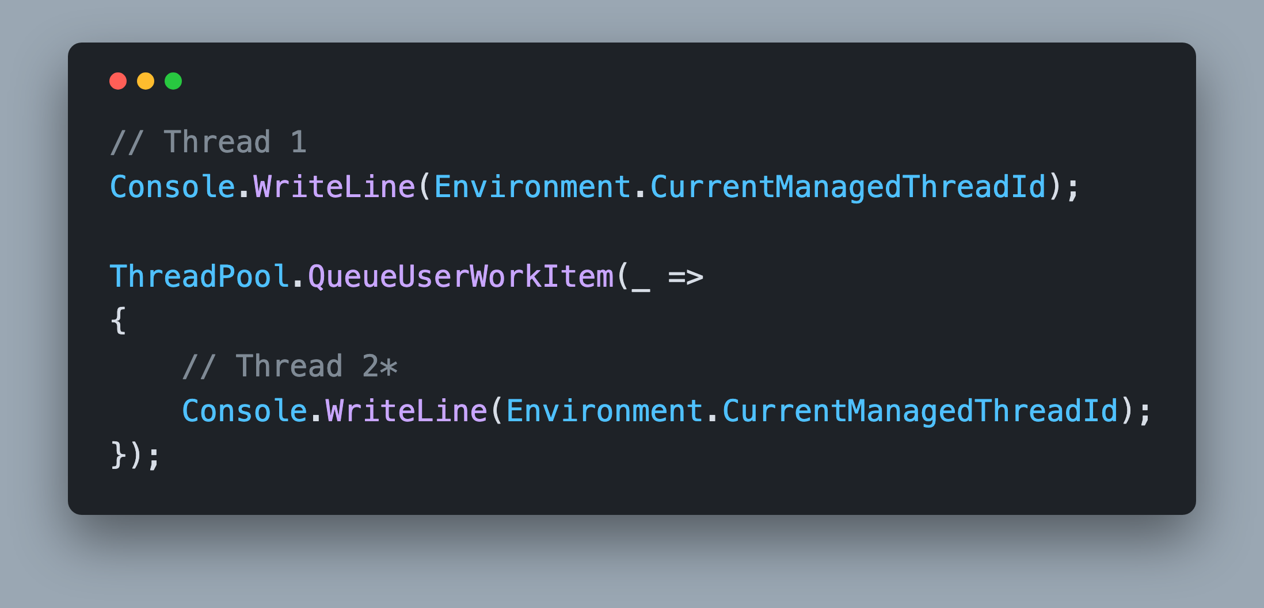
Thread Pool ThreadPool.QueueUserWorkItem()
Runs on a Thread Pool thread*
Complete the Task when the delegate returns
*Can be any thread other than Thread 1, e.g. Thread 32
Notes:
ThreadPool.QueueUserWorkItem() is the primitive behind Task.Run(). You hand it a delegate, and one of the pool's worker threads picks it up as soon as one is free. The caller doesn't wait.
Run this snippet and the two thread Ids will differ. Remember the Thread 1, Thread 2 slides from Day 1? Same idea. It can be any thread other than Thread 1, e.g. Thread 32, and it can be a different number every run. That's exactly what Program.cs demonstrates: it prints the Starting Thread Id, then a thread Id from each CustomTask.
To build Run(Action) you need three things: create a task, queue a delegate that invokes the action, and complete the task when the action returns. Wrap the action in try/catch so a thrown exception completes the task with an exception instead of crashing the pool thread. We cover the exception half in two slides.
One detail for later: QueueUserWorkItem() captures the calling thread's ExecutionContext. There's an Unsafe variant that doesn't. For Run() itself the plain QueueUserWorkItem() is what you want, because the caller's context should flow into the work, just like the real Task.Run().
https://github.com/dotnet/runtime/blob/main/src/libraries/System.Private.CoreLib/src/System/Threading/ThreadPoolWorkQueue.cs

Slide 5
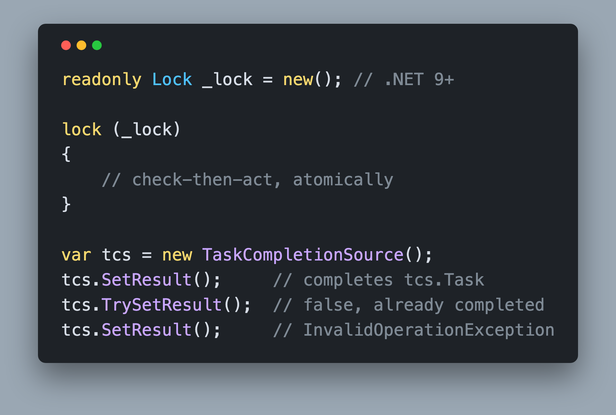
Completion State Complete Exactly Once
Guard with `lock`, .NET 9+ `Lock` type
Check-then-register must be atomic
Second completion throws `InvalidOperationException`
Notes:
Your task will be completed on a pool thread while another thread is registering a continuation or reading IsCompleted, so every read and write of the completion state goes through a lock. .NET 9 added System.Threading.Lock, a dedicated lock object instead of locking on an arbitrary object, and the familiar lock statement understands it. Declare it once as a field, readonly Lock _lock = new(), and use it with the ordinary statement. Your IsCompleted getter reads the flag inside that same lock. Before .NET 9 a plain readonly object field works the same way.
The important part isn't the lock itself, it's what you put inside it. Checking the completed flag and then acting on the answer must be one atomic step. If ContinueWith() checks the flag, releases the lock, and then adds to the list, the task can complete in that gap and your continuation never runs. A ConcurrentQueue would make the add thread safe, but it can't make check-then-add atomic, so a plain List under the lock is the simpler container.
A task also completes exactly once. TaskCompletionSource enforces that rule: call SetResult() twice and the second call throws InvalidOperationException. Your SetResult() and SetException() should share one completion path with the same guard.
https://github.com/dotnet/runtime/blob/main/src/libraries/System.Private.CoreLib/src/System/Threading/Lock.cs
https://github.com/dotnet/runtime/blob/main/src/libraries/System.Private.CoreLib/src/System/Threading/Tasks/TaskCompletionSource.cs

Slide 6
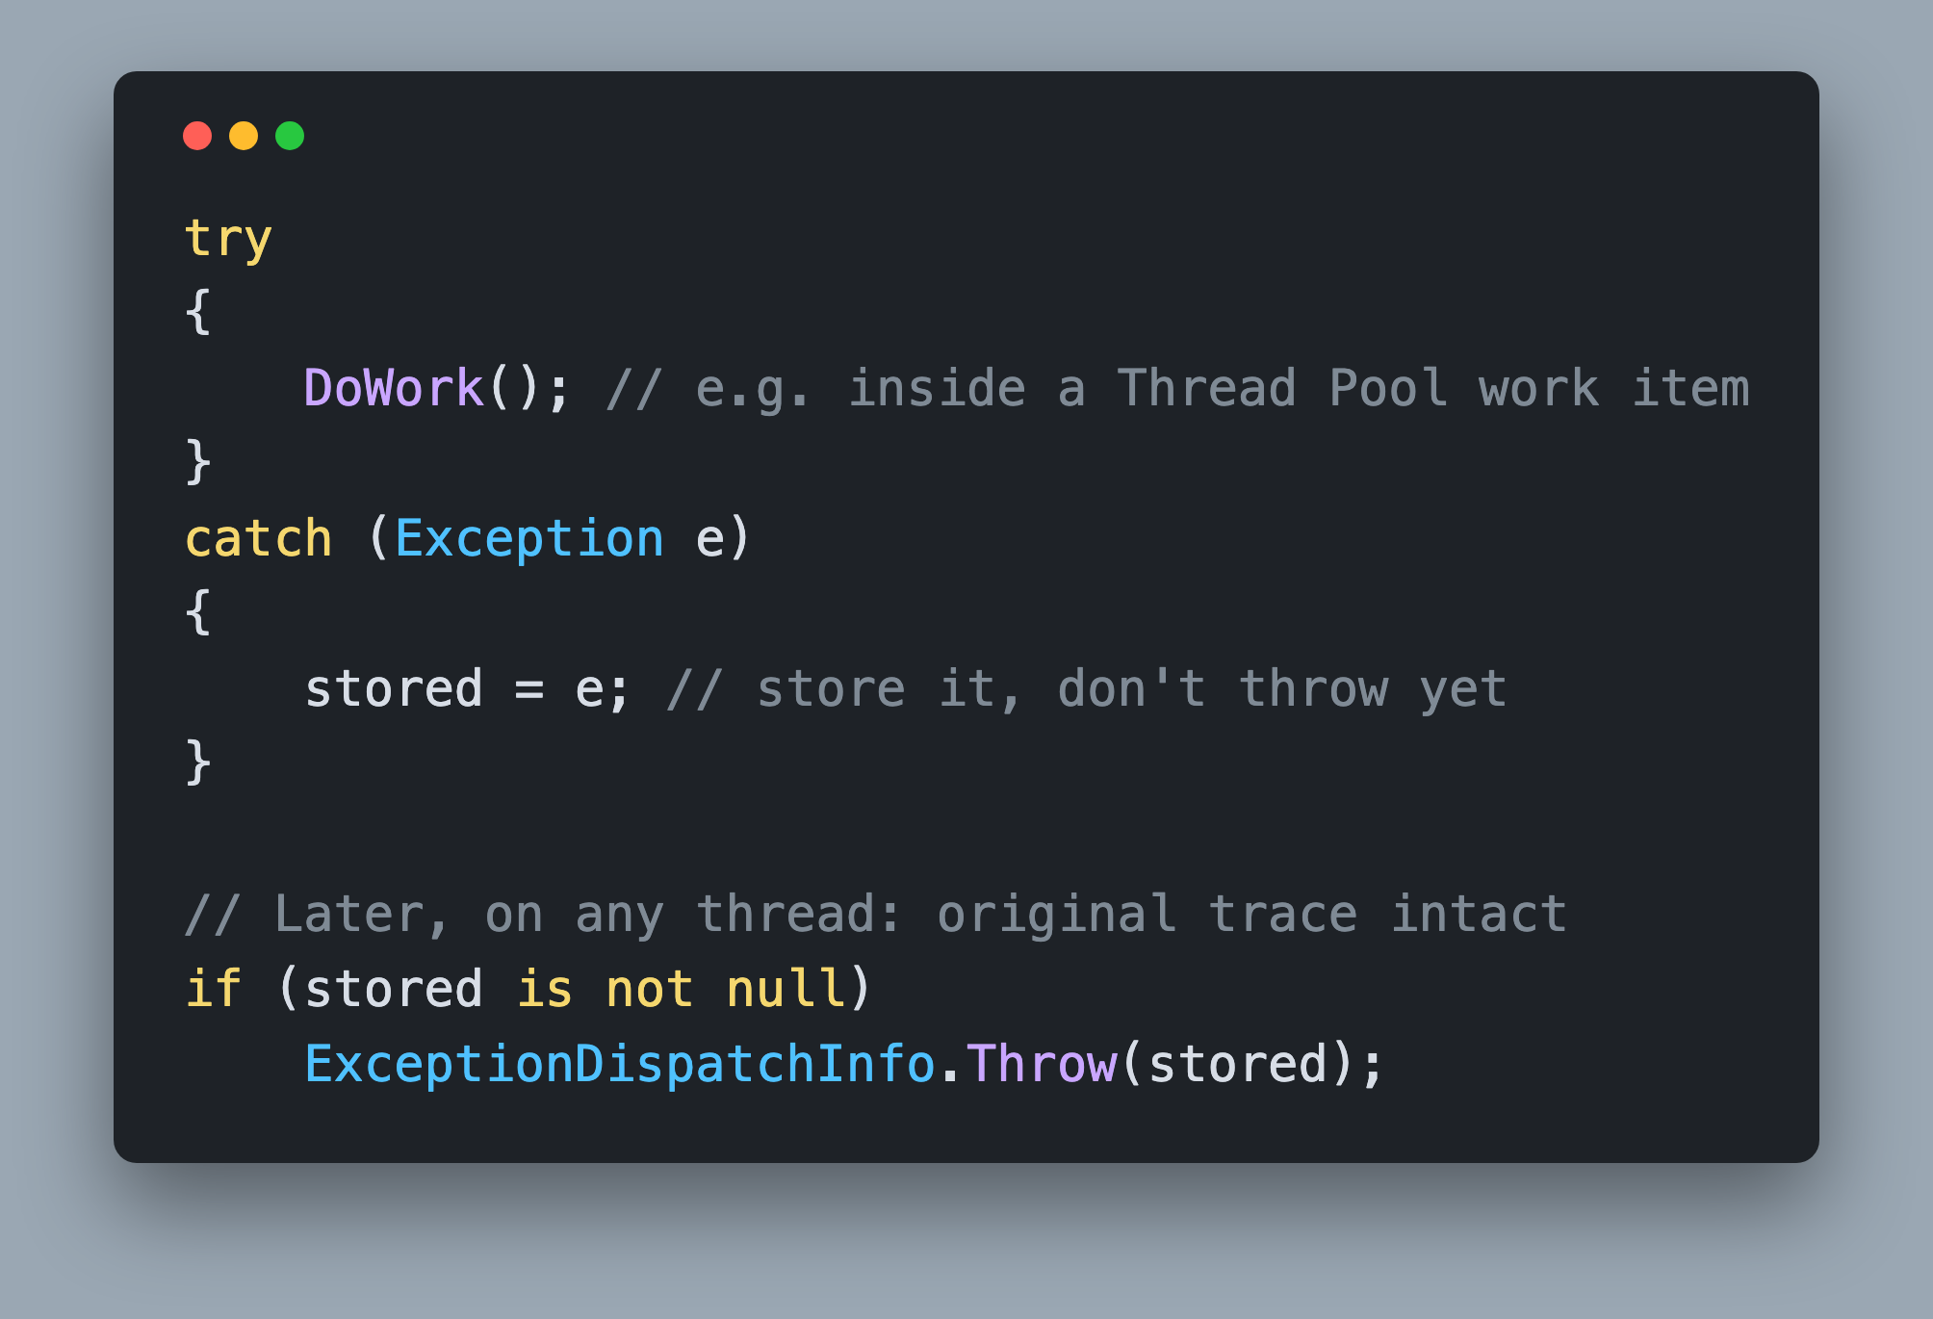
Exceptions System.Runtime.ExceptionServices
Store the `Exception`, rethrow later
`throw ex;` resets the stack trace
`ExceptionDispatchInfo.Throw()` preserves it
Notes:
When the work inside Run() throws, you're on a pool thread and there's nobody above you to catch it. So you catch it, store it on the task, and mark the task complete. The exception is rethrown later, on whichever thread calls Wait() or await.
The trap is how you rethrow. Writing throw ex; on the waiting thread resets the stack trace to that line, so the frames that pointed at the real bug are gone. ExceptionDispatchInfo, in System.Runtime.ExceptionServices, exists to solve exactly this. ExceptionDispatchInfo.Throw(exception) rethrows while keeping the captured trace and appends the new frames underneath. ExceptionDispatchInfo.Capture(exception).Throw() is the older two-step form and does the same thing. That using is already at the top of the starter CustomTask.cs, which is a hint.
TaskAwaiter.GetResult() uses the same machinery to rethrow the first inner exception of a faulted Task. It's why the Best Practices deck told you to prefer GetAwaiter().GetResult() over .Result: one rethrows the original exception, the other wraps it in an AggregateException.
https://github.com/dotnet/runtime/blob/main/src/libraries/System.Private.CoreLib/src/System/Runtime/ExceptionServices/ExceptionDispatchInfo.cs
https://github.com/dotnet/runtime/blob/main/src/libraries/System.Private.CoreLib/src/System/Runtime/CompilerServices/TaskAwaiter.cs

Slide 7
Continuations ContinueWith(Action)
Returns a new `CustomTask` for the continuation
Antecedent already completed: run now
Not yet completed: store for later
Succeeds: `SetResult()` on the returned Task
Throws: `SetException()` on the returned Task
Chained `ContinueWith()` must never hang
Notes:
A continuation is how work resumes. Think back to Day 1: the method started on Thread 1, hit an await, and the rest of it came back on Thread 2, or Thread 5, or Thread 17. The code after the await didn't run by magic. The compiler registered it as a continuation on the Task, and the Task invoked it when it completed. This slide and the next two answer three questions: what does registering a continuation return, how many continuations can one task hold, and where does a continuation actually run.
ContinueWith(Action) returns a new CustomTask that represents the continuation itself, not the original task. That returned task is how chaining works: you can call ContinueWith() on it, await it, or Wait() on it.
Inside there are two paths. If the antecedent has already completed, queue the continuation to the Thread Pool right away. If not, store it so the completion code can run it later. Deciding which path applies is the check-then-act step that belongs inside the lock.
Either way, wrap the action in try/catch. When it returns normally, complete the returned task with SetResult(). When it throws, complete it with SetException(). Skip this and a second ContinueWith() on the returned task waits forever, because nothing ever completes it.
https://github.com/dotnet/runtime/blob/main/src/libraries/System.Private.CoreLib/src/System/Threading/Tasks/Task.cs

Slide 8
Continuations One Task, Many Waiters
One continuation per `ContinueWith()`, `Wait()` and `await`
Single `Action` field: only the last one survives
First waiter never resumes
Store a `List` of pending continuations
On completion: copy + clear inside the `lock`
Dispatch outside the `lock`
Notes:
Here's the bug almost everyone writes first. A task can have many continuations. Two methods can await the same task. One thread can call Wait() while another calls ContinueWith(). Each of those registers its own continuation.
If you keep a single Action field, every registration before completion overwrites the previous one. The first caller's continuation is silently dropped, so that caller, and the task ContinueWith() returned to it, stay incomplete forever. The acceptance check with two waiters on one incomplete task catches exactly this.
So keep a list. When the task completes, copy the list and clear it while you still hold the lock, then release the lock and dispatch the copies. Since the completed flag is already true, any late registration takes the run-now path and nothing is lost.
The real Task keeps continuations in a single object field that is either null, one continuation, or a list, all swapped with Interlocked.CompareExchange. Look for m_continuationObject in Task.cs. Wait() and await both end up registering through that list, so it's the one place all waiters meet.
https://github.com/dotnet/runtime/blob/main/src/libraries/System.Private.CoreLib/src/System/Threading/Tasks/Task.cs

Slide 9
Continuations Queue, Never Inline
Inline invoke recurses
`SetResult()`, continuation, `SetResult()`, continuation...
One stack frame per link in the chain
Several thousand links overflow the stack
Queue every continuation to the Thread Pool
Real `Task` inlines only when it's safe*
*`RuntimeHelpers.TryEnsureSufficientExecutionStack()`
Notes:
It's tempting to invoke continuations directly inside your completion method. It works for one continuation. It doesn't work for a chain of several thousand, which is exactly what the last acceptance check builds.
Follow the call stack. The pool thread calls SetResult() on task one. That runs the completion method, which invokes continuation one inline. Continuation one finishes and calls SetResult() on task two, which invokes continuation two inline, and so on. Nothing returns until the last link completes, so every link adds a frame. A few thousand frames later the process dies with a StackOverflowException, which can't be caught.
The fix is to never invoke inline. Queue every continuation to the Thread Pool. Each completion method then returns immediately, the stack unwinds, and the next link starts fresh on a pool thread. It also makes dispatch uniform: every continuation takes the same path whether or not the thread that registered it had flow suppressed.
The real Task does run some continuations inline, but RunContinuations() in Task.cs calls RuntimeHelpers.TryEnsureSufficientExecutionStack() first and falls back to queuing when the stack gets deep. You don't need that. Always queue.
Which queue method? That's the next two slides.
https://github.com/dotnet/runtime/blob/main/src/libraries/System.Private.CoreLib/src/System/Threading/Tasks/Task.cs
https://github.com/dotnet/runtime/blob/main/src/libraries/System.Private.CoreLib/src/System/Threading/Tasks/TaskContinuation.cs

Slide 10
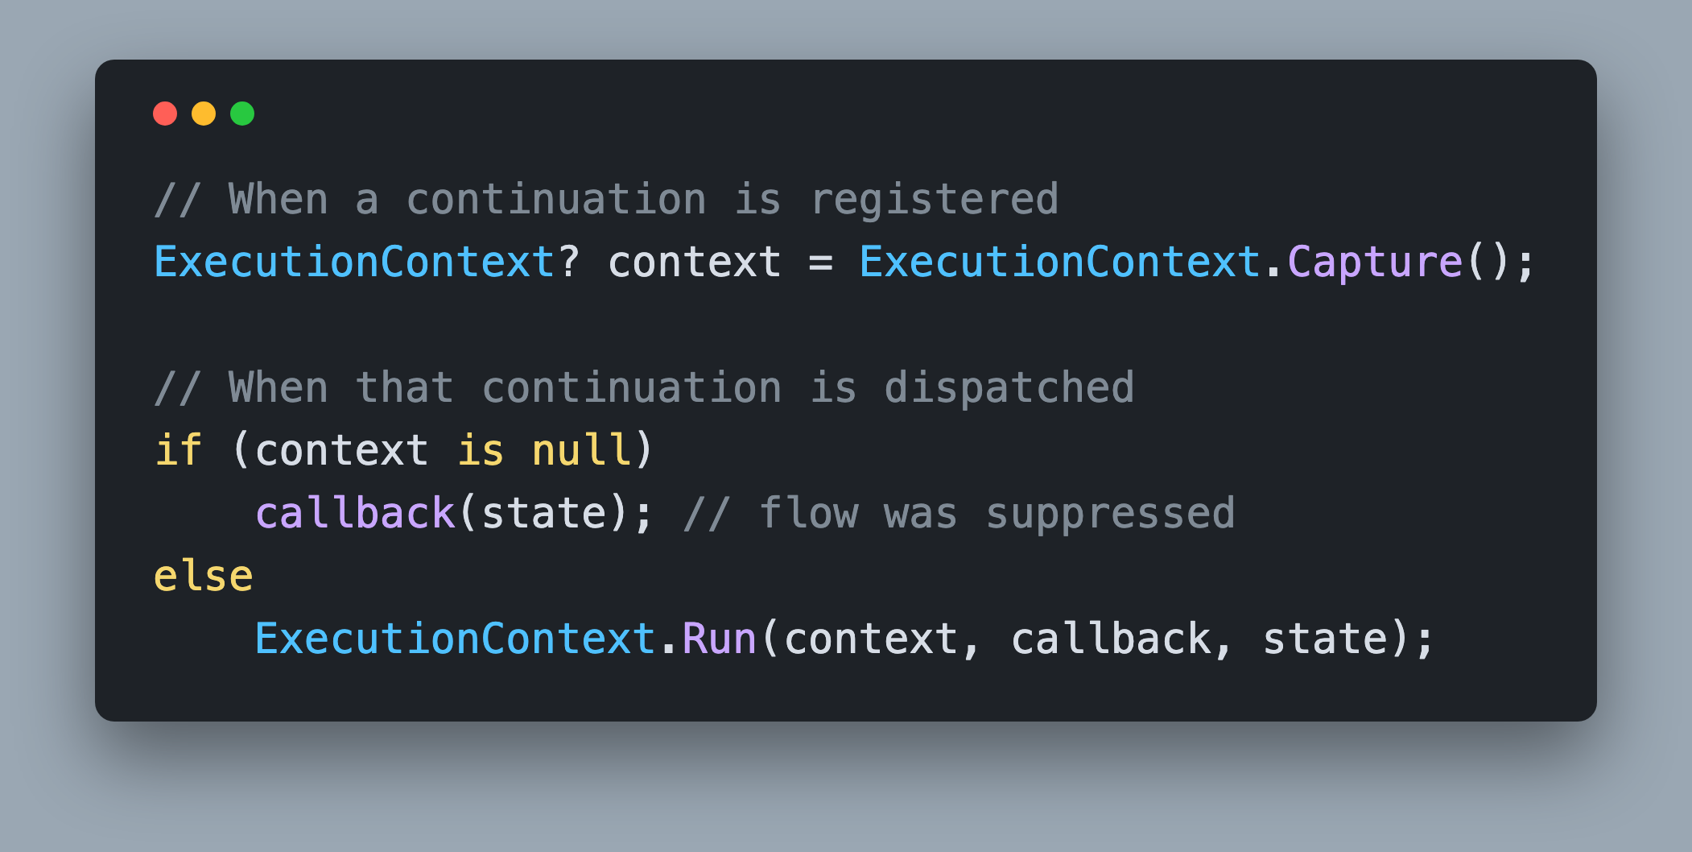
ExecutionContext Capture() on Register, Run() on Dispatch
Same `Capture()` + `Run()` from .NET Internals
`Capture()` returns null when flow is suppressed
Null: invoke directly, nothing to restore
Notes:
This is the direct payoff of this morning's investigation. In the .NET Internals ExecutionContext challenge you set a culture, a principal and an AsyncLocal value on the main thread, captured the context with ExecutionContext.Capture(), and ran a callback on a background thread with ExecutionContext.Run(). The background thread saw the main thread's values. Then you wrapped Task.Run() in ExecutionContext.SuppressFlow() and the values disappeared. Now you build the mechanism that made that happen, automatically, for every continuation.
ExecutionContext.Capture() takes a snapshot of the current thread's ambient state. Call it at the moment a continuation is registered, because that's the caller whose state the continuation expects. ExecutionContext.Run(context, callback, state) restores that snapshot on whatever thread ends up running the continuation, runs the callback, then puts the thread back. Store the captured context next to the continuation so the two travel together.
Capture() returns null when the registering thread had SuppressFlow() active. That's not an error. The caller asked for no ambient state to travel, so invoke the continuation directly on the pool thread's default context.
https://github.com/dotnet/runtime/blob/main/src/libraries/System.Private.CoreLib/src/System/Threading/ExecutionContext.cs

Slide 11
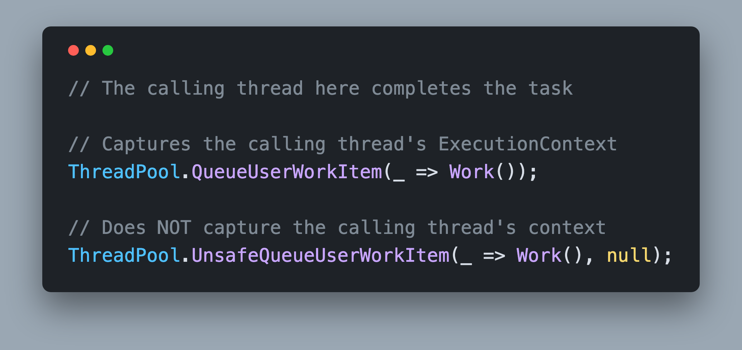
ExecutionContext Never Leak the Completing Thread's Context
`QueueUserWorkItem()` captures the completing thread's context
`UnsafeQueueUserWorkItem()` does not
Restore the registering thread's context in the work item
Notes:
There are two threads with a stake in every continuation: the thread that registered it and the thread that completed the task. Only the first one matters. The completing thread's ambient state, its culture, its principal, its AsyncLocal values, has nothing to do with the code that's waiting. Letting it leak in is the async version of the ThreadStatic data leak we discussed this morning, where re-used threads in ASP.NET Core carry one request's data into another.
ThreadPool.QueueUserWorkItem() silently captures the calling thread's ExecutionContext and restores it inside the work item. When you dispatch continuations from your completion method, the calling thread is the completing thread, so that's exactly the leak to avoid.
ThreadPool.UnsafeQueueUserWorkItem() skips that capture. Use it in the dispatch loop, then restore the registering thread's context inside the work item with ExecutionContext.Run(). If the captured context is null, invoke directly and nothing leaks in from either side.
The run-now branch of ContinueWith() is different. There the calling thread is the one registering, so plain QueueUserWorkItem() already captures the right context and no manual Capture() is needed. Unsafe is only for the completion path.
https://github.com/dotnet/runtime/blob/main/src/libraries/System.Private.CoreLib/src/System/Threading/ThreadPoolWorkQueue.cs

Slide 12
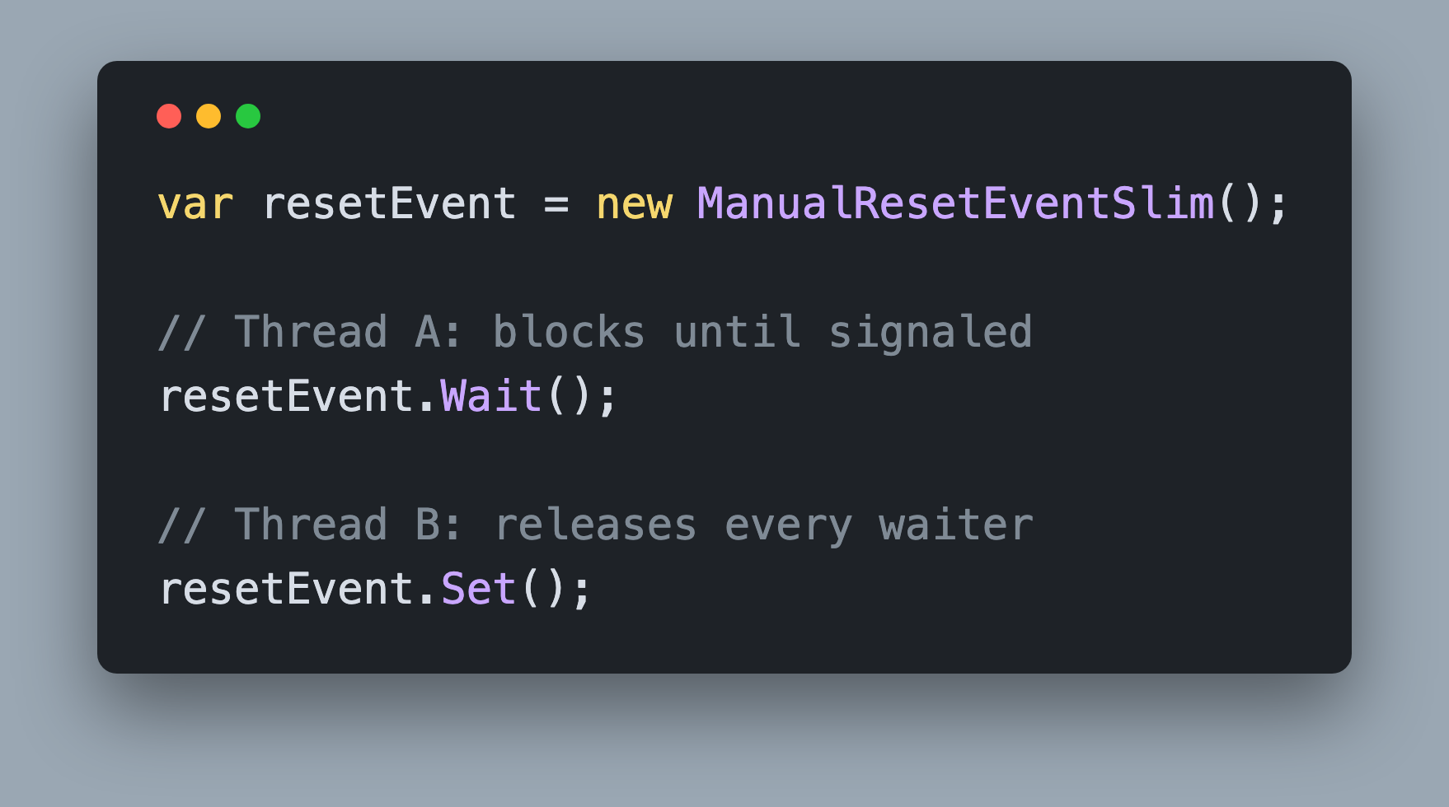
Blocking Waits ManualResetEventSlim
`Set()` signals, `Wait()` blocks until signaled
Register `Set()` as a continuation
After waking, rethrow any stored `Exception`
Notes:
Wait() blocks the calling thread until the task completes. We spent Day 1 telling you never to block, and the reason stands: a blocked thread is wasted and can deadlock a UI thread. But the challenge asks for it because await needs a synchronous way to observe the outcome, and because Task.Wait() exists and you should know how it's built.
ManualResetEventSlim is the primitive. Wait() blocks until someone calls Set(). Once set, it stays set, so every current and future waiter passes straight through.
Reuse the machinery you already built. Only create the event when the task is still incomplete, and register its Set() as a continuation while you hold the lock so the check and the registration are atomic. Calling ContinueWith() from inside your lock is fine: the lock statement, Monitor and the .NET 9 Lock type are all reentrant, so the same thread can enter a lock it already holds.
When the wait returns, check the stored exception and rethrow it with ExceptionDispatchInfo.Throw() so the caller sees the original stack trace. Because the event goes through the same continuation list as everything else, two callers blocking on one task each get their own event and both wake up.
https://github.com/dotnet/runtime/blob/main/src/libraries/System.Private.CoreLib/src/System/Threading/ManualResetEventSlim.cs

Slide 13
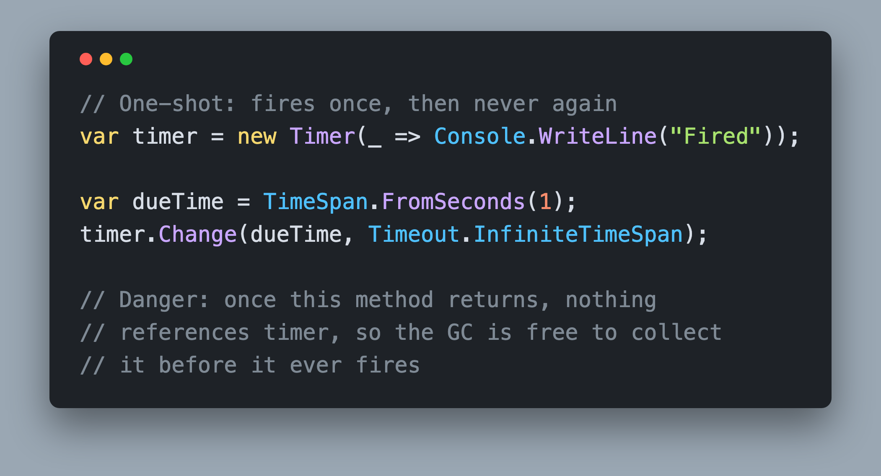
Timers System.Threading.Timer
`Change(dueTime, Timeout.InfiniteTimeSpan)` fires once
No live reference: GC can collect it before it fires
`Dispose()` from inside the callback
Notes:
Delay(TimeSpan) returns a task that completes when a timer fires. System.Threading.Timer runs its callback on a Thread Pool thread, and Change(dueTime, Timeout.InfiniteTimeSpan) turns it into a one-shot: wait once, never repeat.
The subtle part is lifetime, and it's the bug that will cost you the most time. A Timer is an ordinary managed object. If nothing holds a reference to it, the garbage collector is free to collect it before it ever fires, and your Delay() task silently never completes. Your Delay() method creates the timer and returns, so ask yourself what's still referencing it while it waits. One answer is to give the callback itself a reference to the timer, which means declaring the variable before you assign it.
Dispose the timer from inside the callback, then complete the task. That releases the timer's slot in the runtime's timer queue.
Task.Delay() is implemented the same way. Open Timer.cs and read TimerQueueTimer, then look for DelayPromise in Task.cs: it's a Task that owns one of these timers and completes itself when it fires.
https://github.com/dotnet/runtime/blob/main/src/libraries/System.Private.CoreLib/src/System/Threading/Timer.cs
https://github.com/dotnet/runtime/blob/main/src/libraries/System.Private.CoreLib/src/System/Threading/Tasks/Task.cs

Slide 14
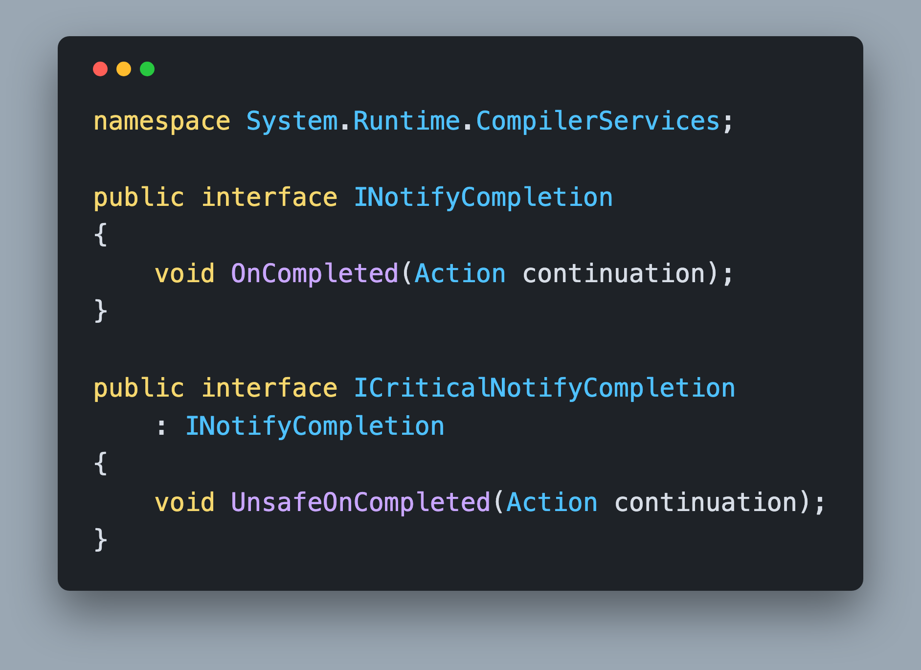
Awaiter Pattern INotifyCompletion
`GetAwaiter()` returns the awaiter
Awaiter: `IsCompleted`, `OnCompleted(Action)`, `GetResult()`
`UnsafeOnCompleted()` is optional
Notes:
The C# compiler doesn't know what a Task is. It doesn't check for a base class or an interface on the awaited expression. It duck-types a pattern, and this is the whole pattern.
The awaited type needs a GetAwaiter() method. The thing it returns needs three members: a bool IsCompleted property, a void OnCompleted(Action continuation) method, and a GetResult() method that returns void or the result type and rethrows if the task faulted. OnCompleted() is the one member that must come from an interface, INotifyCompletion in System.Runtime.CompilerServices, which is why that using is already at the top of the starter CustomTask.cs.
ICriticalNotifyCompletion adds UnsafeOnCompleted(), the no-ExecutionContext-flow version. The compiler prefers it when present because the awaiter can skip its own context capture; the method builder already handles the flow. It's optional and you don't need it for this challenge.
A readonly struct works well for the awaiter. Every member can be a one-liner, so think about which CustomTask member already does each job.
https://github.com/dotnet/runtime/blob/main/src/libraries/System.Private.CoreLib/src/System/Runtime/CompilerServices/INotifyCompletion.cs
https://github.com/dotnet/runtime/blob/main/src/libraries/System.Private.CoreLib/src/System/Runtime/CompilerServices/TaskAwaiter.cs

Slide 15
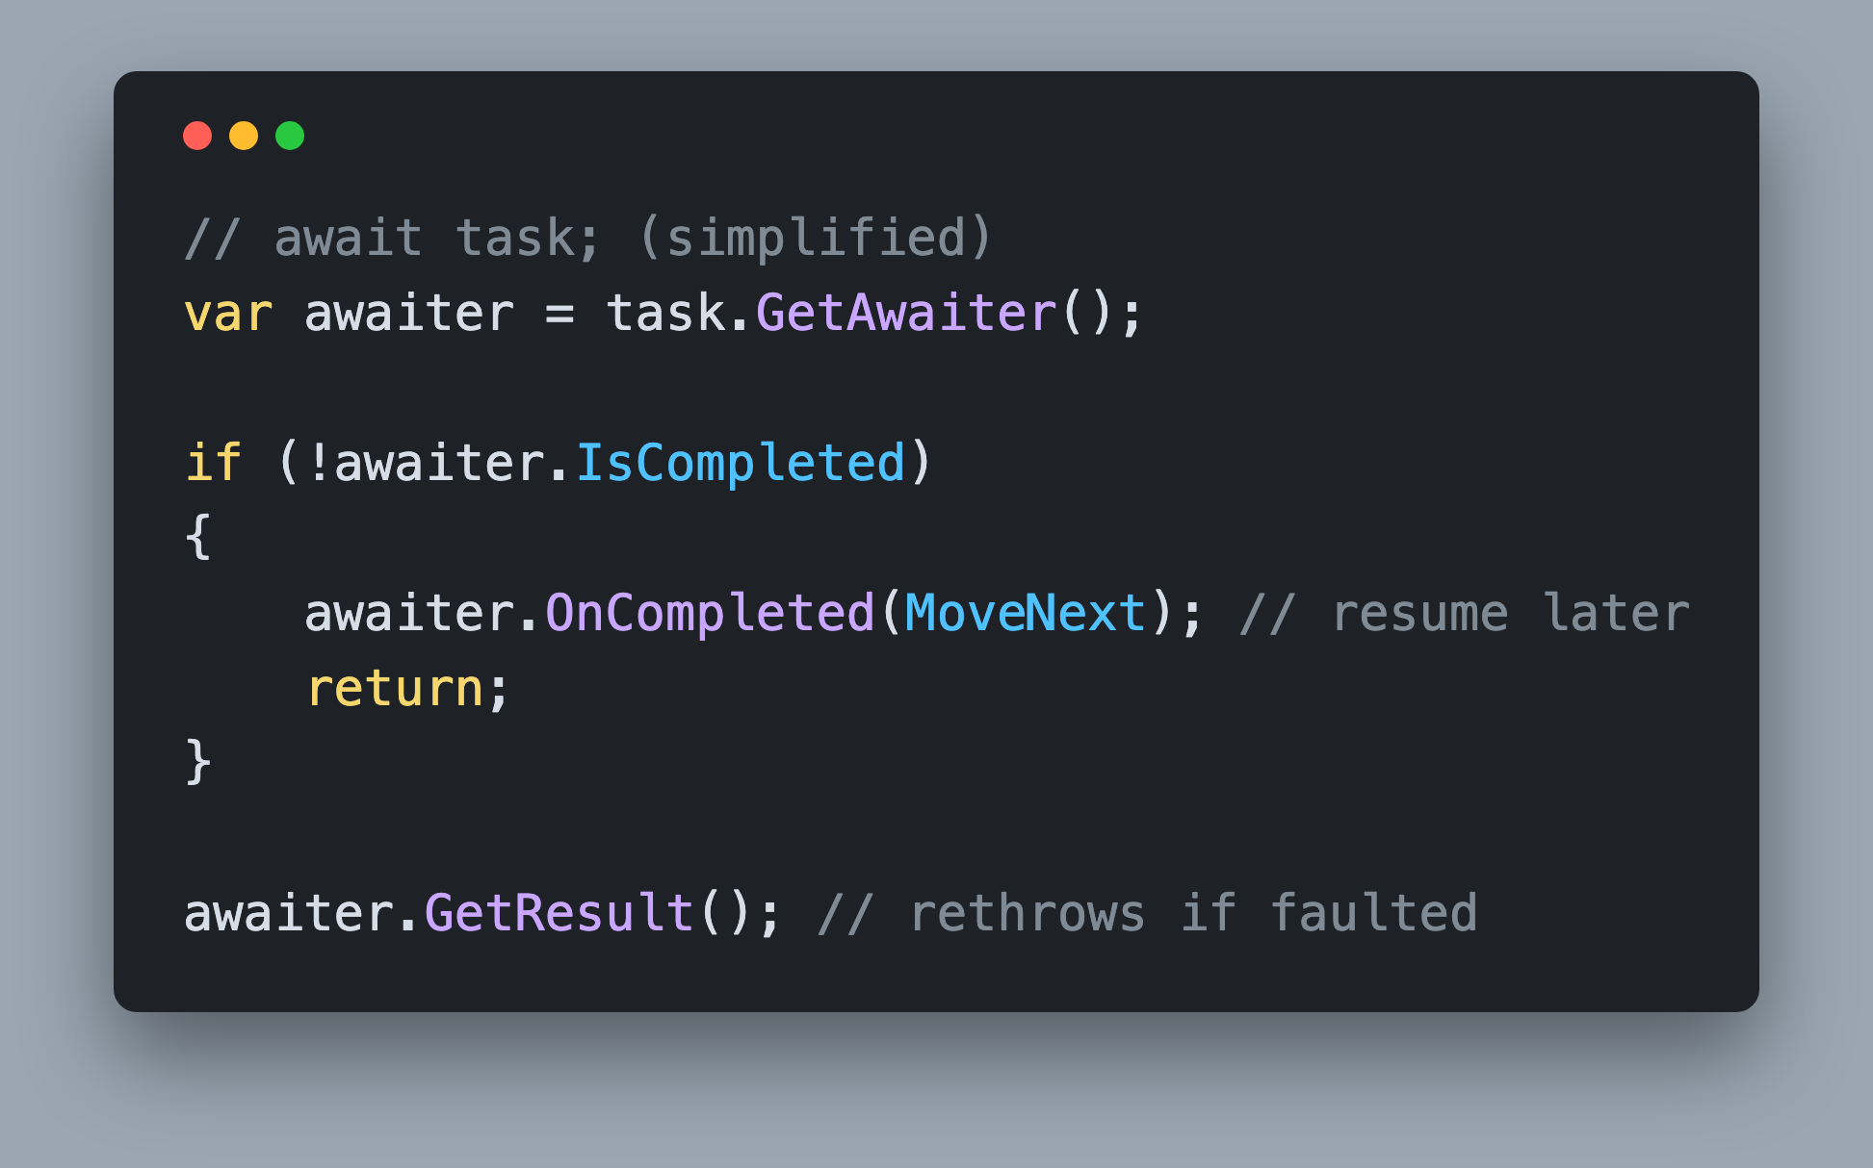
Compiler Generated Code What await Expands To
Day 1 state machine, revisited
`IsCompleted` first, `OnCompleted(MoveNext)` if pending
`GetResult()` when it resumes
Notes:
Back to Day 1. When the compiler rewrites an async method into a state machine, every await becomes roughly this snippet inside MoveNext().
First it calls GetAwaiter() on the awaited expression. Then it checks IsCompleted. If the task is already done, it skips straight to GetResult() and keeps running synchronously: no thread switch, no continuation. If it isn't done, it hands MoveNext itself to OnCompleted() as the continuation and returns, freeing the thread. When your task completes and invokes that continuation, MoveNext() runs again, lands back in the same state, and calls GetResult() to fetch the value or rethrow the exception.
The hand-off to OnCompleted() actually goes through AsyncTaskMethodBuilder.AwaitOnCompleted(), which captures ExecutionContext and boxes the state machine so it can be resumed later, but the shape is the same.
Notice that nothing here mentions Task. Your CustomTaskAwaiter satisfies every call in this snippet, so the compiler is happy.
https://github.com/dotnet/runtime/blob/main/src/libraries/System.Private.CoreLib/src/System/Runtime/CompilerServices/AsyncTaskMethodBuilder.cs
https://github.com/dotnet/runtime/blob/main/src/libraries/System.Private.CoreLib/src/System/Runtime/CompilerServices/AsyncMethodBuilderCore.cs

Slide 16
Await Is Just a Pattern
Any Type With GetAwaiter() Can Be Awaited
Notes:
This is the whole point of the section. The await keyword isn't tied to Task. It's tied to a pattern of four members, and any type that provides them can be awaited.
That means the C# language feature and the .NET library type are independent. The language team defined the pattern so the runtime team, and you, could plug in whatever completion object made sense. Task happened to be the first and most common implementation, which is why people conflate the two.
Once your CustomTask exposes GetAwaiter(), the top-level await in Program.cs compiles with no changes to the compiler, no attributes, no registration. The compiler finds the method by name, checks the three members on the awaiter, and generates the same state machine it generates for Task.
It also means every async/await behavior you've ever debugged, thread switches, context capture, exceptions surfacing at the await instead of where they were thrown, lives in the awaiter and the task, not in the keyword. If you take one idea home from today, take this one.
https://github.com/dotnet/runtime/blob/main/src/libraries/System.Private.CoreLib/src/System/Runtime/CompilerServices/INotifyCompletion.cs

Slide 17
Built-in Awaiters Same Pattern, Different Awaiter
`Task` returns `TaskAwaiter`
`ValueTask` returns `ValueTaskAwaiter`
`Task.Yield()` returns `YieldAwaitable`
`IsCompleted` always false, always yields
`ConfigureAwait(false)` returns `ConfiguredTaskAwaitable`
Same `Task`, different awaiter, skips the `SynchronizationContext`
`CustomTask` returns `CustomTaskAwaiter`
Notes:
Everything you've awaited in this workshop is a type that satisfies the pattern.
Task.GetAwaiter() returns TaskAwaiter, a readonly struct whose OnCompleted() registers a continuation on the task. ValueTask has ValueTaskAwaiter, which checks whether the result is already available before touching a Task at all. Task.Yield() returns YieldAwaitable, whose IsCompleted is always false so the continuation is always queued, which is how it forces a hop back to the scheduler.
ConfigureAwait(false) is the interesting one from Day 1. It returns ConfiguredTaskAwaitable, which wraps the same task but whose awaiter passes continueOnCapturedContext as false when it registers the continuation. That single boolean is why the continuation doesn't marshal back through the SynchronizationContext you inspected in the Blazor sample this morning. Different awaiter, different behavior.
One more built-in worth knowing: TaskCompletionSource is the way to create a Task and complete it by hand with SetResult() or SetException(), the same surface you're building on CustomTask. And the moment CustomTask.GetAwaiter() returns a CustomTaskAwaiter, your type joins this list.
https://github.com/dotnet/runtime/blob/main/src/libraries/System.Private.CoreLib/src/System/Runtime/CompilerServices/TaskAwaiter.cs
https://github.com/dotnet/runtime/blob/main/src/libraries/System.Private.CoreLib/src/System/Runtime/CompilerServices/YieldAwaitable.cs
https://github.com/dotnet/runtime/blob/main/src/libraries/System.Private.CoreLib/src/System/Runtime/CompilerServices/ValueTaskAwaiter.cs

Slide 18
Program.cs Top-Level await
Top-level statements support `await`
Compiler only needs the awaiter pattern
Prints the Starting Thread Id
Then three `CustomTask` Thread Ids
From `Run()`, after `Delay()`, from `Run()`
Final version uses `await`, not `Wait()`
Notes:
The starter Program.cs only prints the Starting Thread Id. Your finished version drives every piece you built.
Use top-level statements. Since C# 9 a top-level program can await directly, because the compiler wraps the file in an async Main for you. That async Main only needs the awaiter pattern, so awaiting a CustomTask works the moment GetAwaiter() exists.
The expected output is four lines: the Starting Thread Id, then a thread Id printed from inside CustomTask.Run(), then one printed after awaiting CustomTask.Delay(), then one from a second CustomTask.Run(). The three CustomTask Ids come from pool threads, so expect them to differ from the starting Id and often from each other.
The final version must use await, not Wait(). Get everything working with Wait() first if that helps, then swap every Wait() for await. That final swap is the moment the whole thing clicks: the compiler never knew what a Task was, it only knew the pattern.
https://github.com/dotnet/runtime/blob/main/src/libraries/System.Private.CoreLib/src/System/Threading/Tasks/Task.cs

Slide 19
Let's Build a Task
Notes:
Time to switch from listening to typing.
Before you open the IDE, take thirty seconds and say back to yourself what a Task is: a completion flag, a stored exception, a list of continuations, and a lock around all three. Everything you're about to write is a method that reads or writes that state.
Build up to it in stages. Start with Run() and Wait() to prove completion works and print a thread Id. Add ContinueWith() and the shared completion method, and chain two. Add Delay(). Then add the awaiter and swap every Wait() for await.
Test as you go. Chain two ContinueWith() calls, then Wait() on the task the second one returned; if that Wait() never returns, the returned task is never being completed. For two waiters, and for the several-thousand-link chain, start from CustomTask.Delay(TimeSpan.FromSeconds(1)) so the task is still pending when you register. That detail matters: if the antecedent has already finished, every ContinueWith() takes the run-now path and the recursion you're testing for never happens.
Use the .NET source when you get stuck. Task.cs and TaskAwaiter.cs are the reference implementation of what you're building, and the two usings at the top of the starter file are your hints.
https://github.com/dotnet/runtime/blob/main/src/libraries/System.Private.CoreLib/src/System/Threading/Tasks/Task.cs
https://github.com/dotnet/runtime/blob/main/src/libraries/System.Private.CoreLib/src/System/Runtime/CompilerServices/TaskAwaiter.cs

Slide 20
Challenge Build an Awaitable CustomTask
Build `CustomTask` in 45 minutes
Builds, prints Starting Thread Id + three `CustomTask` Ids
Continuation runs after the first task completes
Chained `ContinueWith()` never hangs, two waiters both resume
Several-thousand-link chain, no stack overflow
AI Agents: understand, interpret errors, ask questions*
*Not to solve the challenge. You're smart. You got this.
Notes:
Open 4. Creating Custom Implementation of Task/1. Start/CreatingTaskFromScratch.slnx, build it once so you know the starter compiles, and open the empty CustomTask.cs. Notice the two usings already at the top: System.Runtime.CompilerServices for INotifyCompletion and System.Runtime.ExceptionServices for ExceptionDispatchInfo.
You're building Run(Action), ContinueWith(Action), Wait(), Delay(TimeSpan) and GetAwaiter() with a CustomTaskAwaiter, plus the completion state underneath them. CustomTaskAwaiter doesn't exist yet. Add a new file, CustomTaskAwaiter.cs, next to CustomTask.cs, which is where 2. Finish keeps it; a nested struct inside CustomTask also works. Then update Program.cs so the final version uses await instead of Wait().
You're done when the solution builds and prints the Starting Thread Id and three CustomTask Ids, a continuation runs after the first task completes, chaining ContinueWith() on the task returned by ContinueWith() doesn't wait forever, two callers waiting on the same incomplete task both resume, and a chain of several thousand ContinueWith() calls finishes without a stack overflow.
Recommended time is 45 minutes. Use AI Agents to understand the existing code, clarify task-like type concepts, interpret errors and ask questions. Please don't let them solve the challenge. You're smart. You got this. We'll review approaches as a group before opening SOLUTION.md together.

